Slide 1
Music Genre Classification with 2D CNN
Feridun Cemre Gülten
Ceren Yılmaz Gülten

Slide 2
Agenda
Introduction
3
Primary goal
4
Dataset
5
Data Pre-Processing
10
Model and Demo
13

Slide 3
Introduction
3
Music Genre Classification is one of the important development
subjects nowadays due to the music industry and music
platforms. Most of the music platforms use music genre based
platform to present more efficient and joyful experience to
their users such as Spotify.

Slide 4

Primary Goal
Build high accuracy model for Music Genre Classification

Slide 5










Dataset
Rock
Folk
Hip-Hop
Experimental
600 MP3 File
600 MP3 File
600 MP3 File
600 MP3 File
Electronic
Pop
Instrumental
International
600 MP3 File
600 MP3 File
600 MP3 File
600 MP3 File

Slide 6
Data Pre-Processing

Slide 7
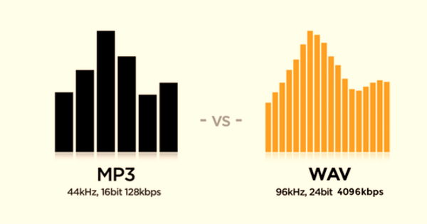
MP3 to WAV Format

Slide 8
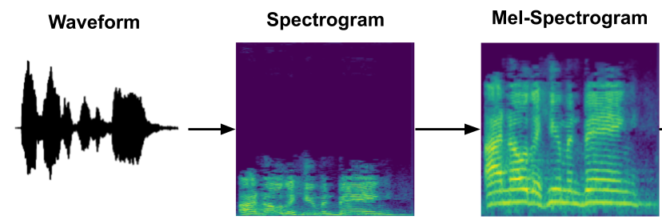
WAV to Spectrogram

Slide 9
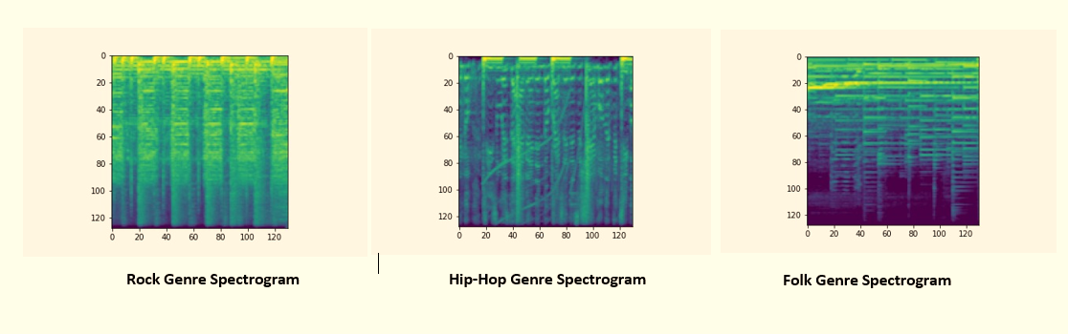
Spectrograms

Slide 10
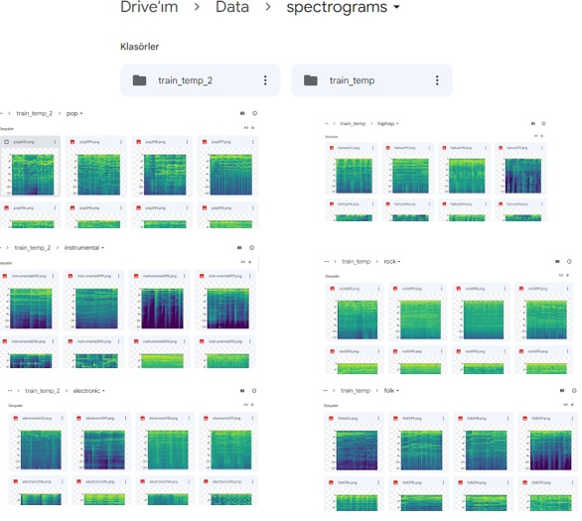
Data Screenshot in Drive

Slide 11
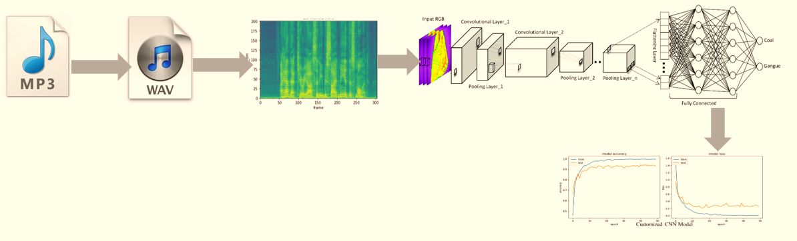
Project Pipeline

Slide 12
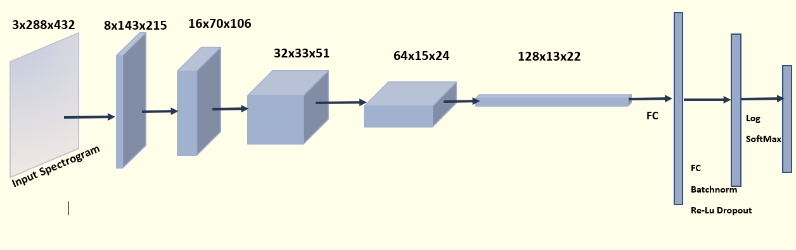
CNN Model

Slide 13
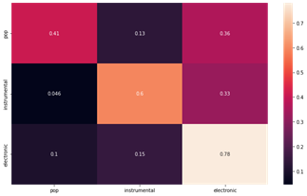
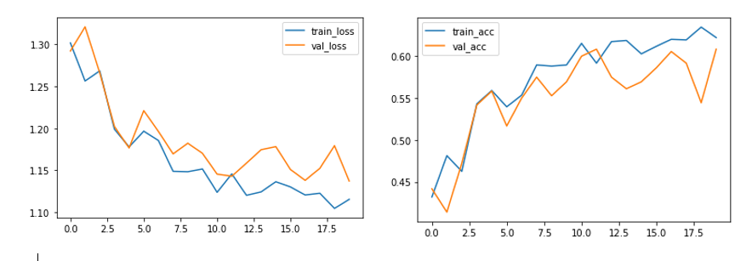
CNN Model Results
Hip-Hop, Folk, Rock Genre Classification Loss and Accuracy
Confusion Matrix

Slide 14
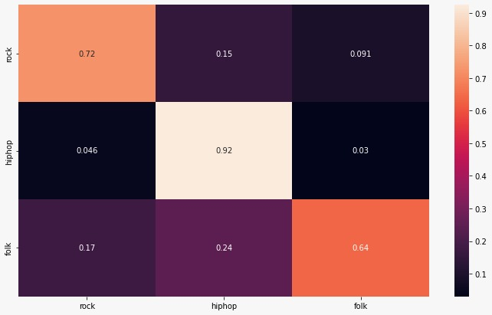
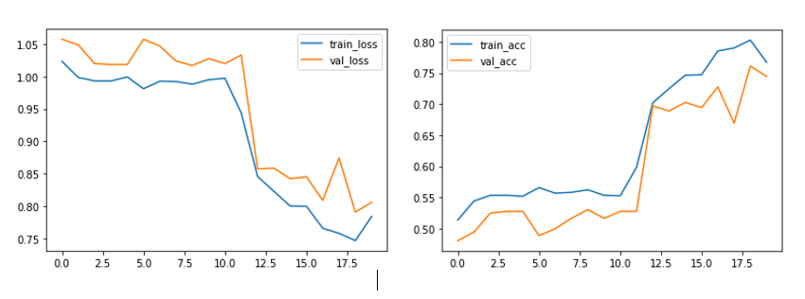
CNN Model Results
Pop, Electronic, Instrumental Genre Classification Loss and Accuracy
Confusion Matrix

Slide 15
Thank you

